Slide 1

Latinos Educando Juntos
Monthly Provider Meeting
22 DE MARZO DE 2024

Slide 2

Lenguaje de nuestro corazón
Todos tenemos derecho a comunicarnos y participar en el idioma en el que nos sentimos más cómodos: el lenguaje de nuestro corazón.

Slide 3

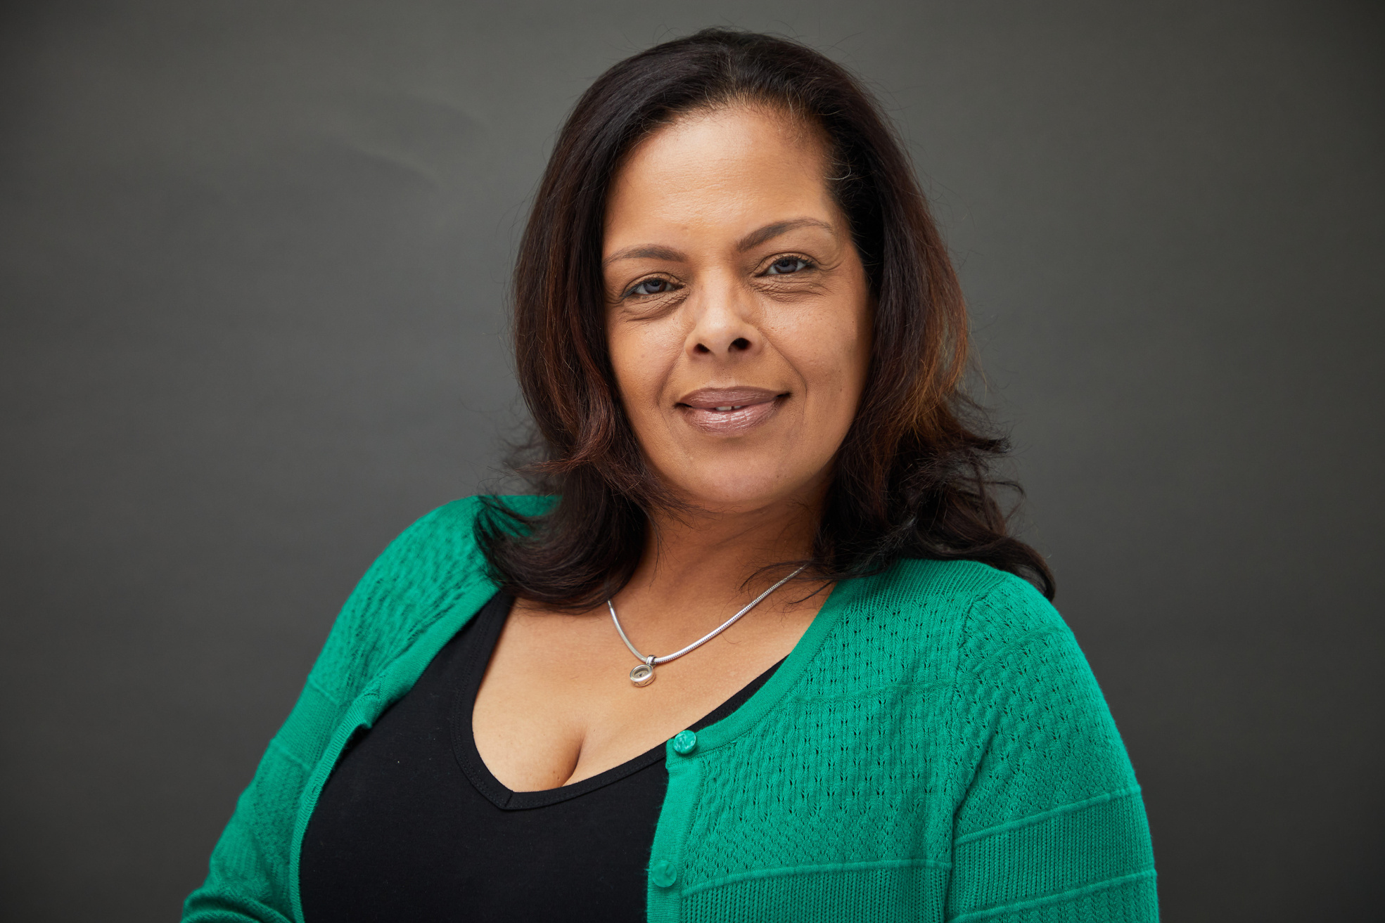
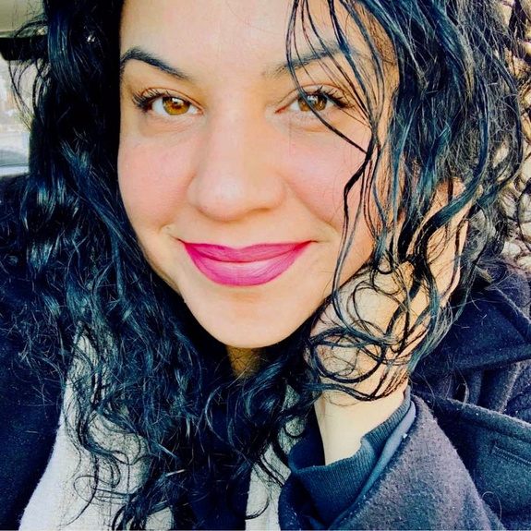
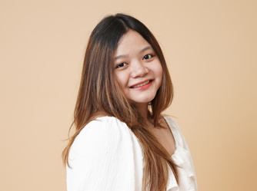
Hosts
Damaris
Alvarado-Rodriguez
Martha Gee
Stefanie Francisco
Ideal Phila
LEJ Board Member
President
Latinos Educando Juntos
LEJ Virtual Assistant

Slide 4

Reglas de la Casa!
Housekeeping Rules
  ·Su nombre, nombre de la organización y su correo electrónico en el cuadro de chat
  ·Por favor, permanezca en silencio
  ·Levante la mano para hablar o reactive el audio para hacer preguntas
  ·Use el cuadro de chat y compartiremos
  ·Las sesiones se están grabando y se compartirán en el sitio web
  ·Activar las opciones de idioma de transcripción traducida
  Si está buscando crédito PQAS, por favor ponga su # de Pakeys en el chat y debe permanecer en la reunión durante un mínimo de 90 minutos para recibir crédito.
  Your Name, Name of organization, and your email in the chat box
  Please remain muted
  Raise Hand to talk or unmute to ask questions
  Use Chat box and we will share
  Sessions are being recorded and will be shared in the website
  Activate Translated transcription Language options
  If you are looking for PQAS credit please put your PAKeys Registry # in the Chat and you must remain in the meeting for a minimum of 90 minutes to receive credit.

Slide 5


Rompehielos
¿Comparte algunas celebraciones, ya sea en su vida, en sus programas o en su trabajo?
Ice Breaker
Share some celebrations either in your life or programs or work?

Slide 6

Janetta (Netta) Radzinski
OCDEL’s Special Assistant for External Relations.
Notes:
Netta couldn't be here today. She is extremely busy with preparing for the OCDEL Conference.
How Many people here have scheduled for the conference?
LEJ will have a table at the conference. Come visit us for some goodies.

Slide 7

OCDEL Conference
March 25th & March 26th
How Many Providers that need Translation services registered for the conference?
If you have registered for the conference and require Spanish Translation services, send us an email at info@latinosEducandoJuntos.org
Visit our LEJ Table at the Conference! See you there!!!

Slide 8

Diane Getzinger
Assistant Director of Provider/STARS
Gladys Leon
Provider/ STARS Quality Coach
ELRC Region 18
Philadelphia County

Slide 9


Slide 10
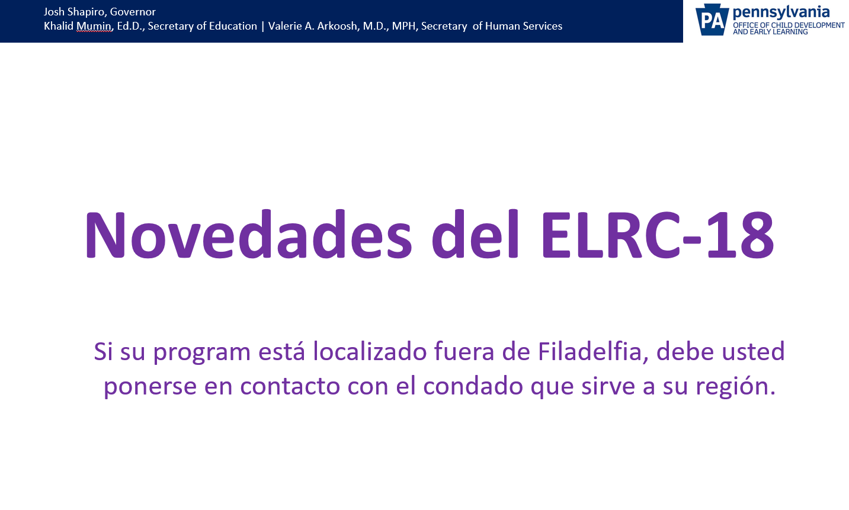

Slide 11
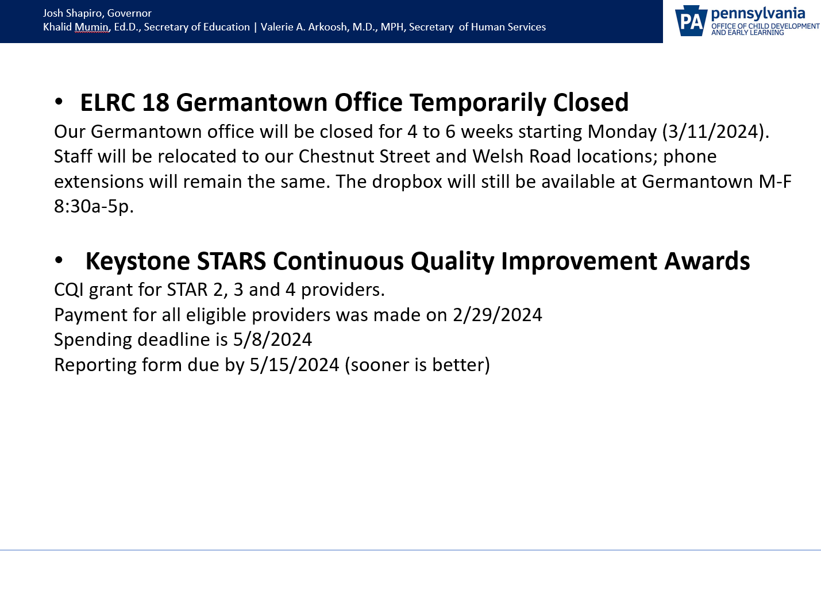

Slide 12
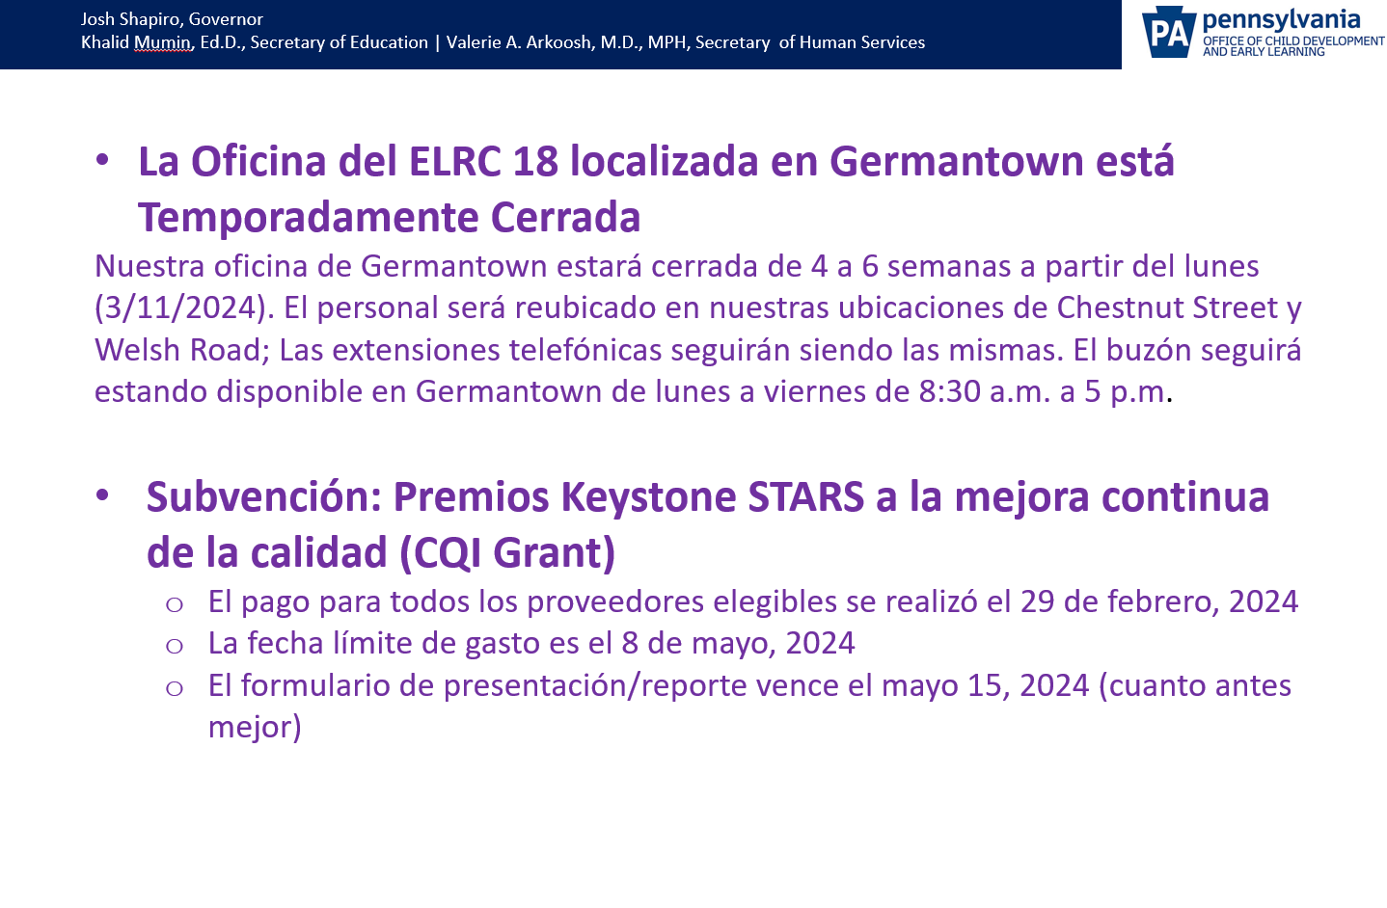

Slide 13
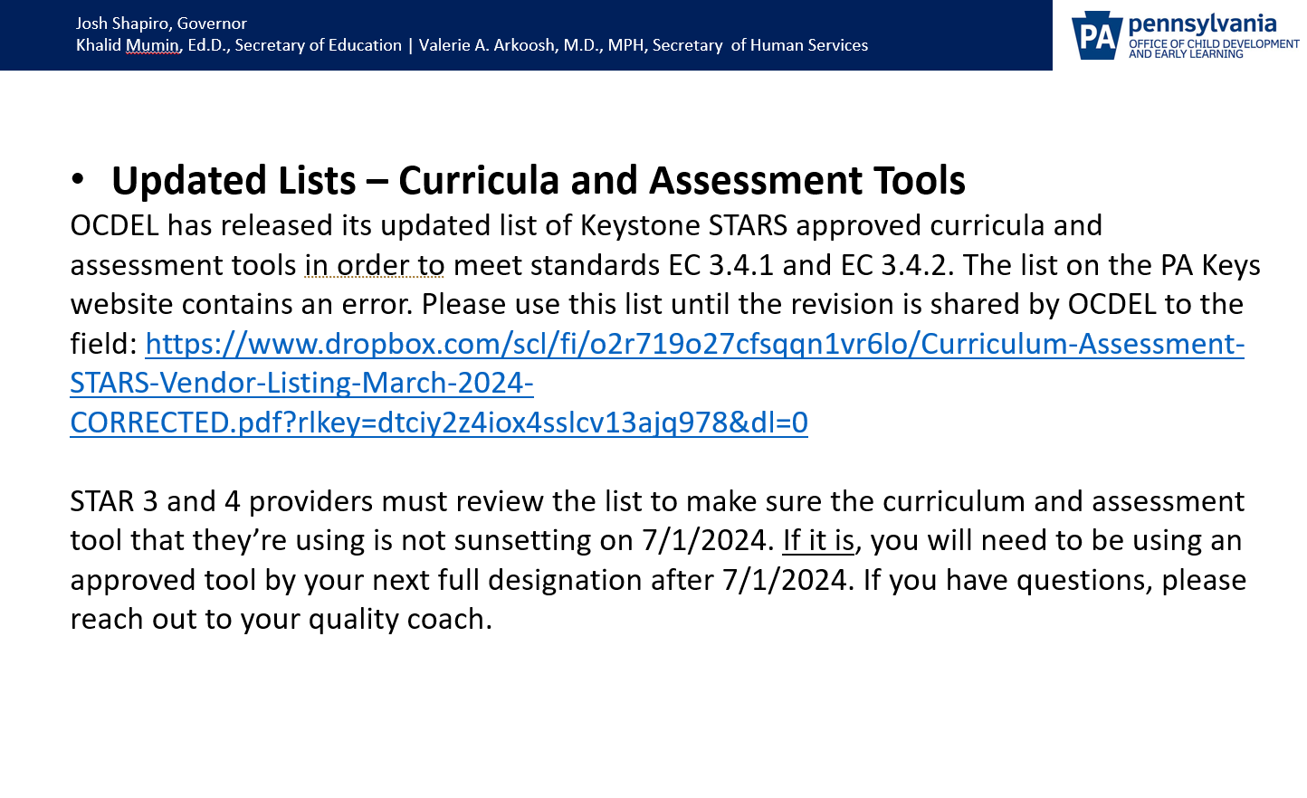

Slide 14
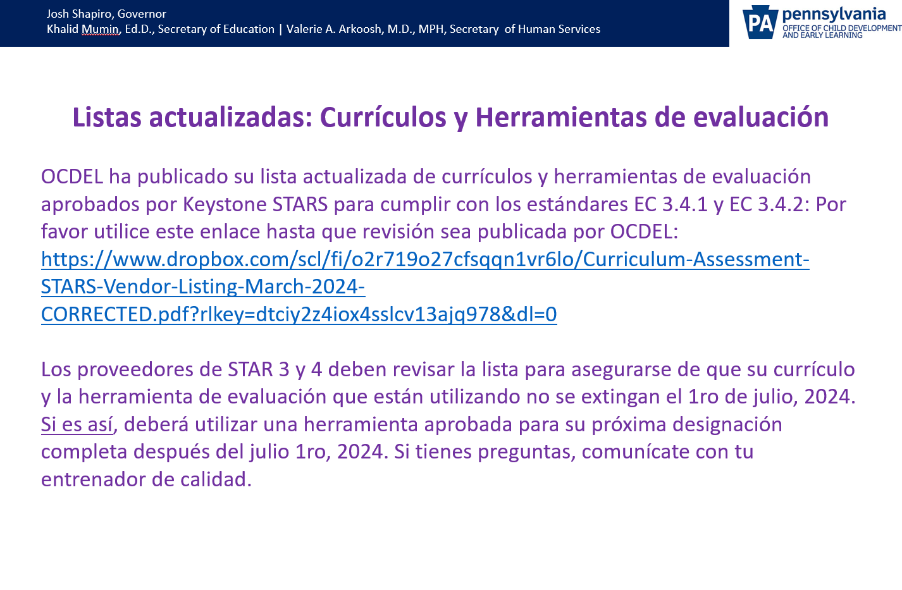

Slide 15
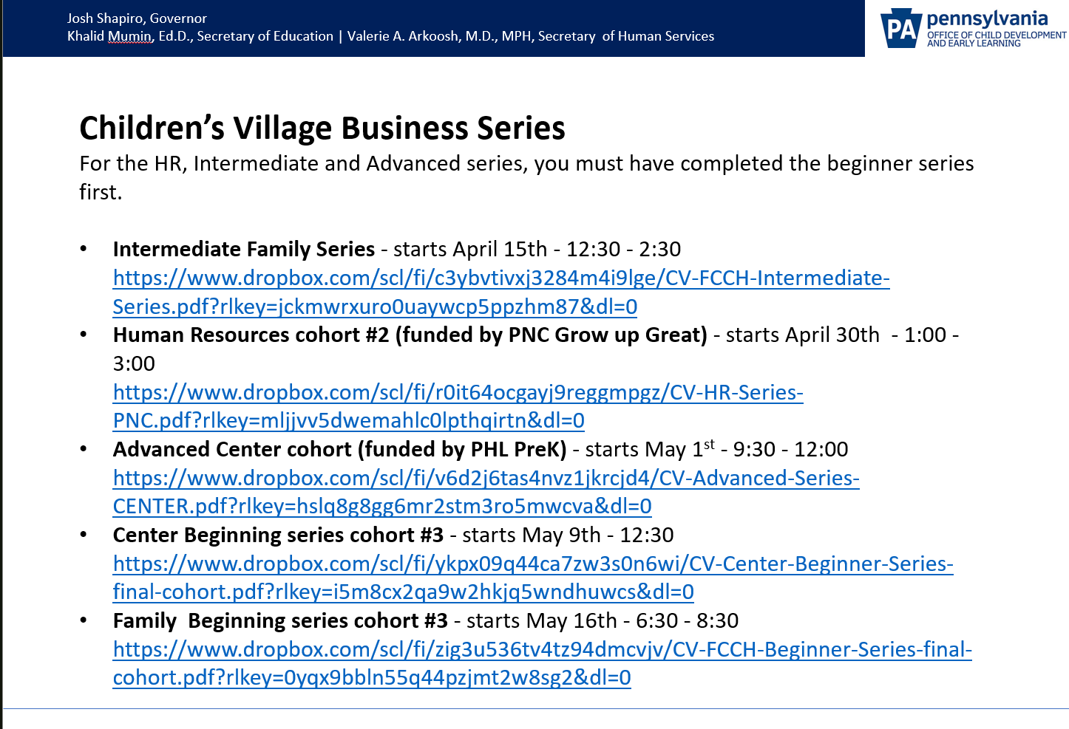

Slide 16
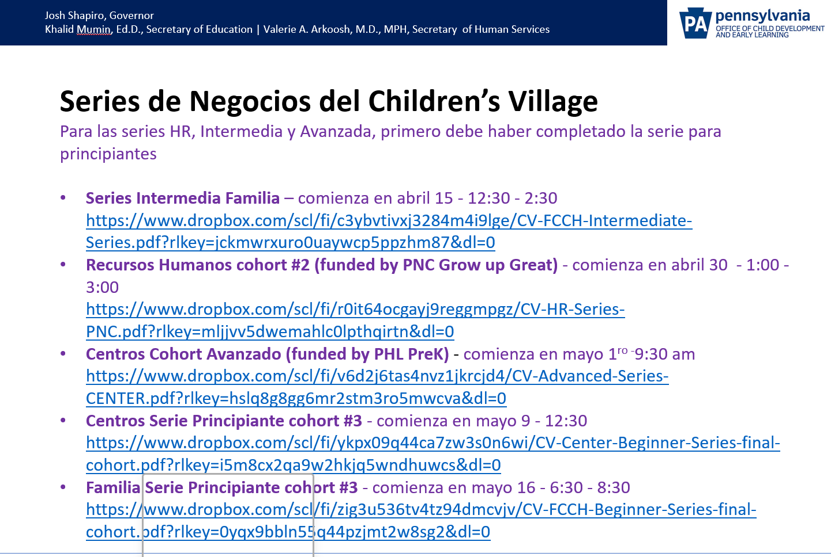

Slide 17
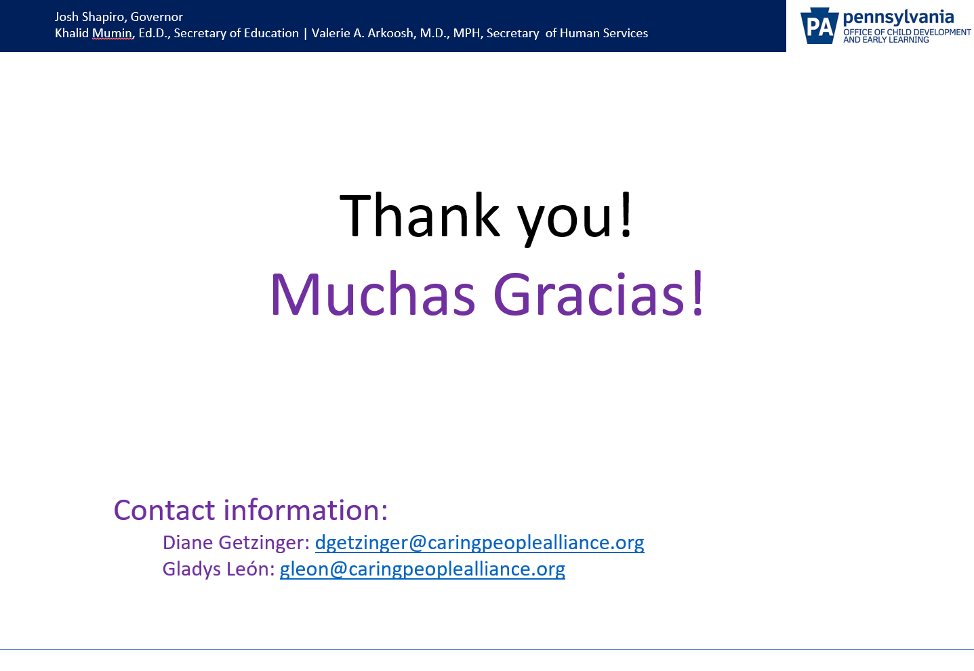

Slide 18
Erica Cisneros
Star Quality Coach
CSC Downtown
Early Learning Resource Center 14

Slide 19


Zulma Guzman
Promotora De Salud

Slide 20


Slide 21
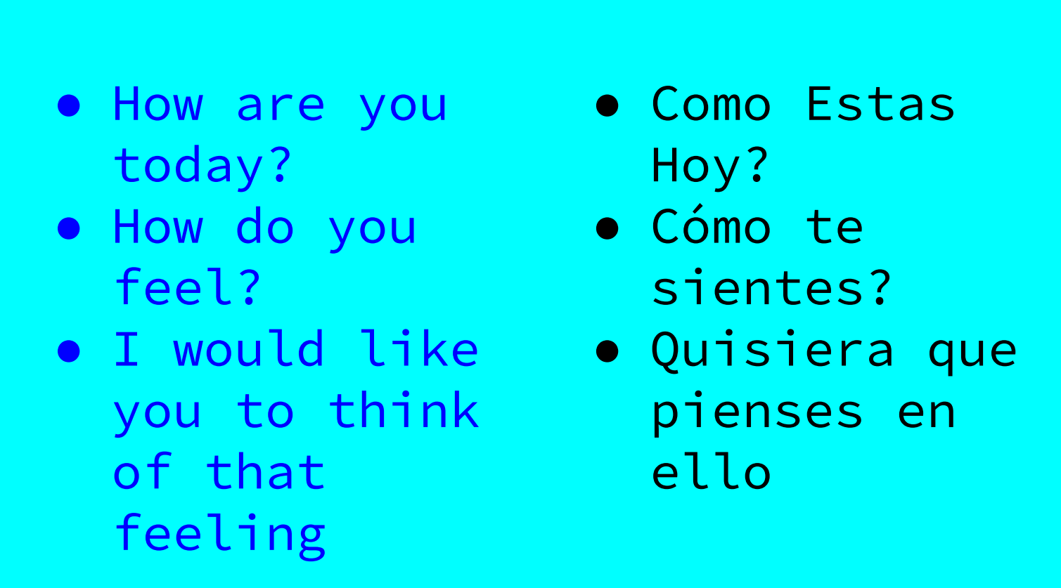

Slide 22


Slide 23


Slide 24


Slide 25
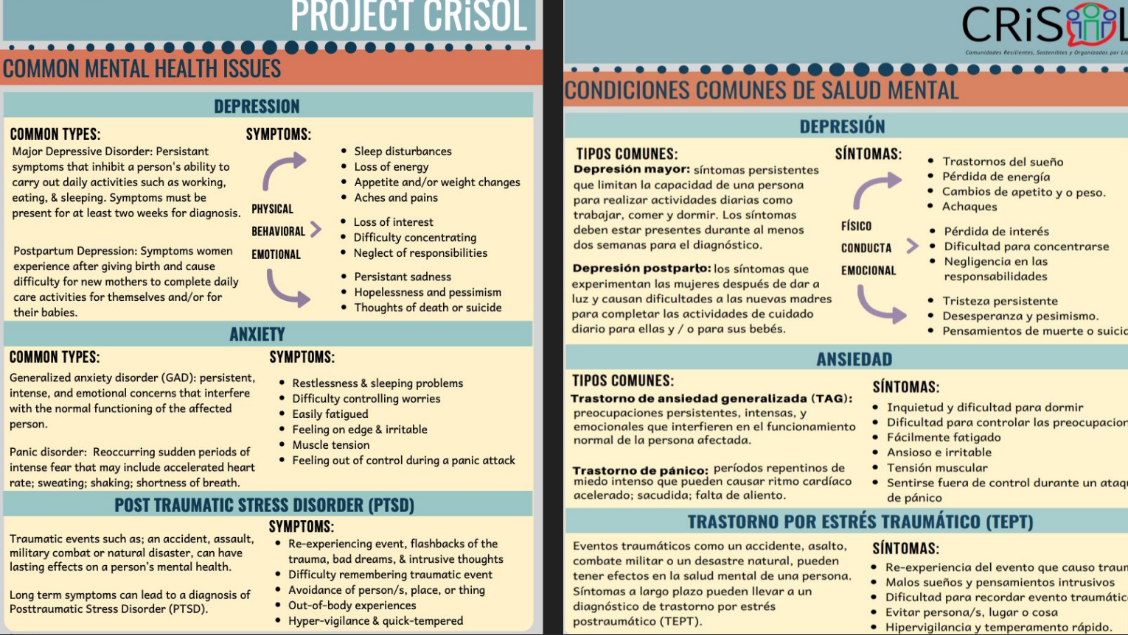

Slide 26
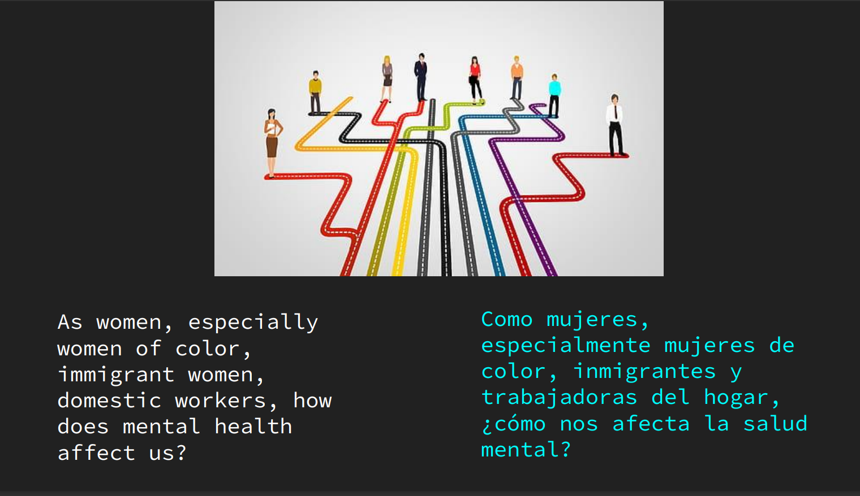

Slide 27


Slide 28
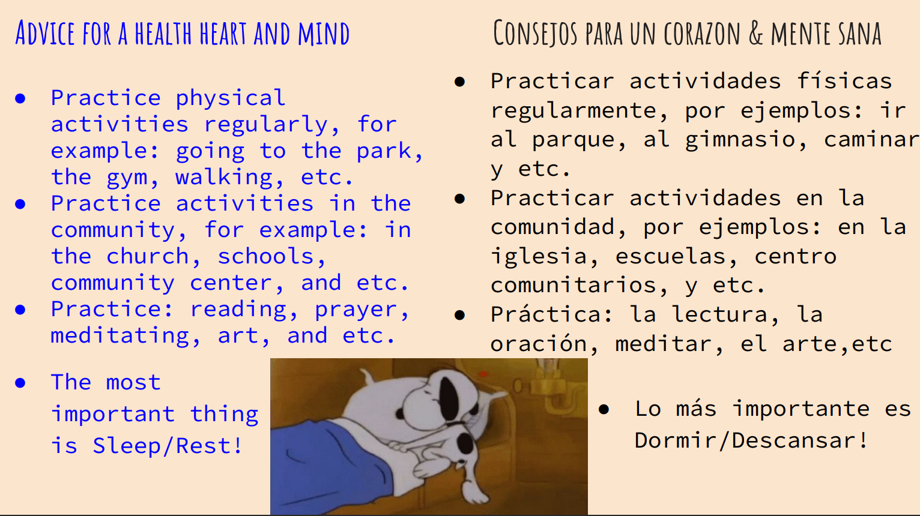

Slide 29


Slide 30
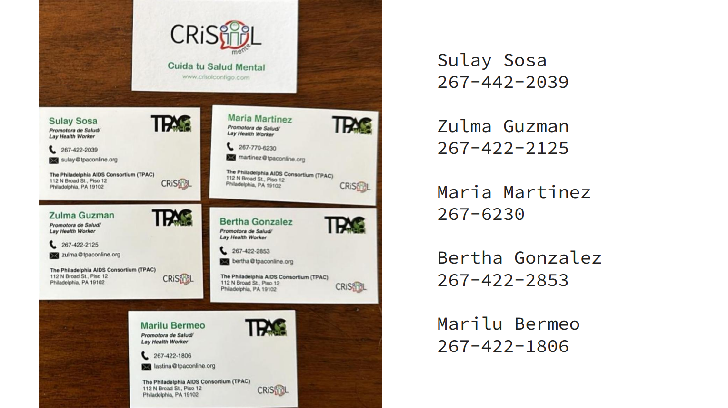

Slide 31

QUESTIONS/PREGUNTAS???

Slide 32


Alison Wunder Stahl
Senior Director of Partnership Strategy
Technical Assistance
Yazmin Iglesias
Director of Technical Assistance People Projects & Process
All Our Kin, Inc.
Notes:
Is on Vacation this week soaking up the sun...
Damaris Will share

Slide 33
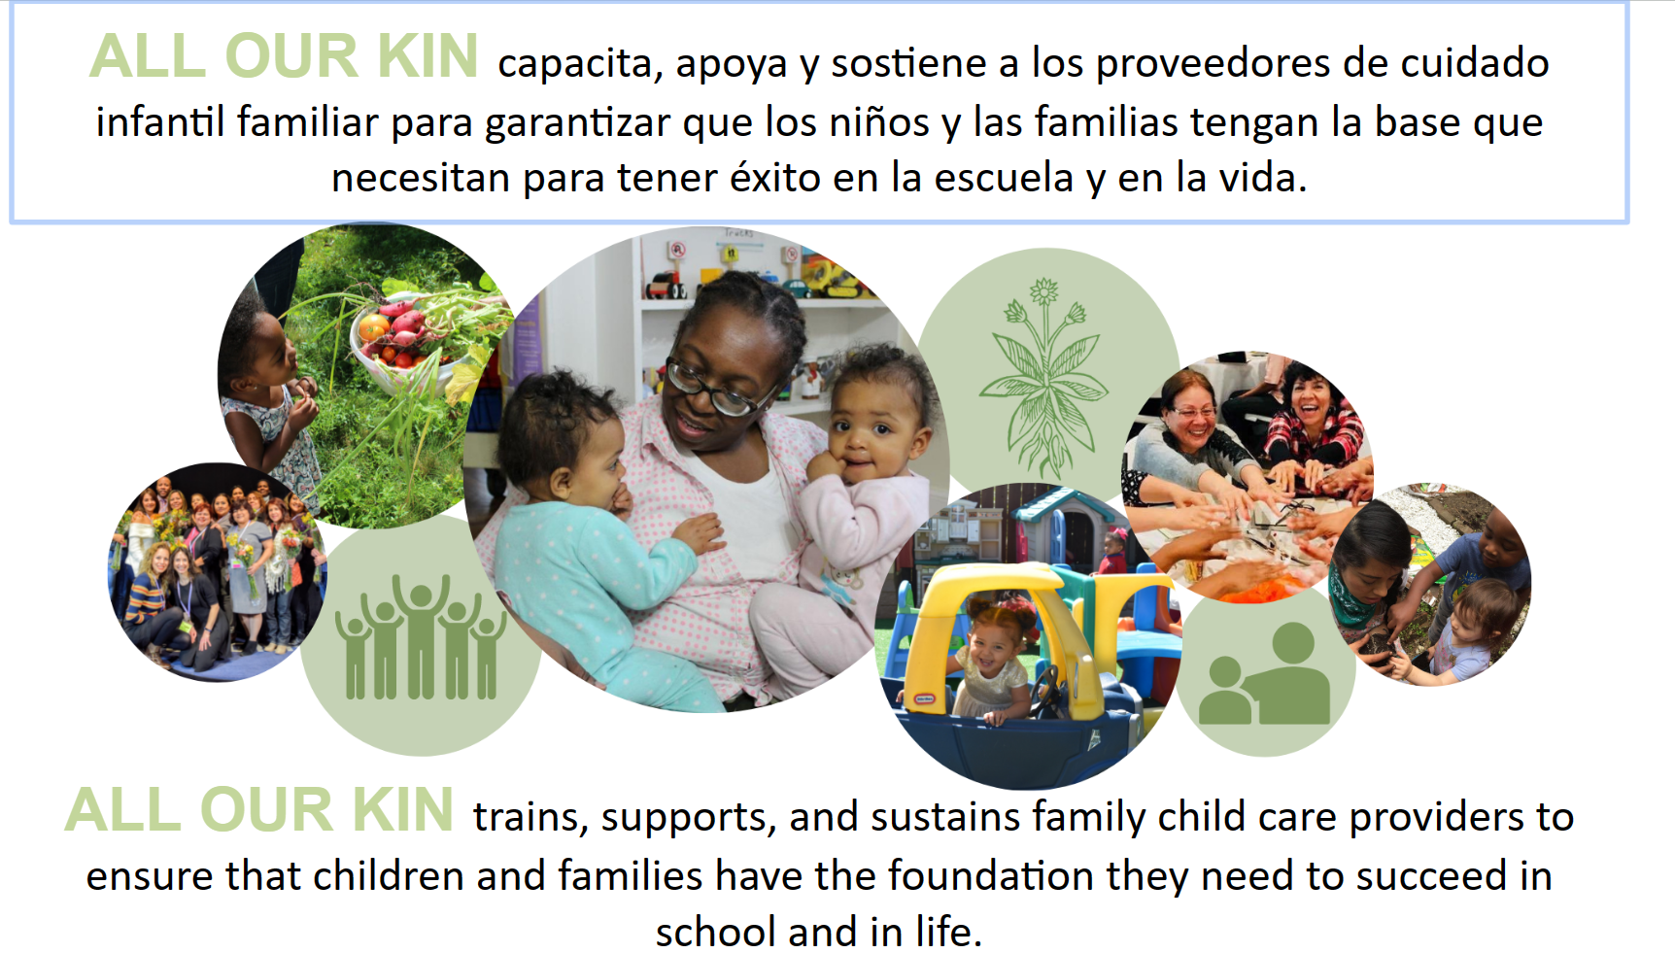

Slide 34
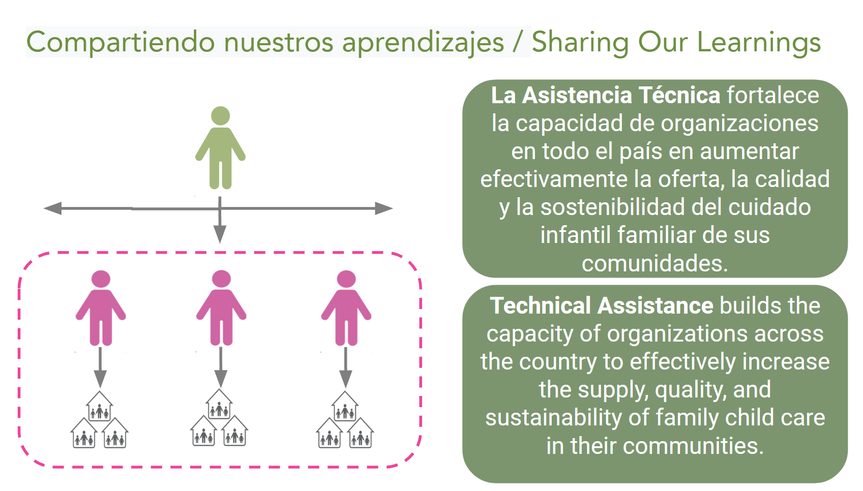

Slide 35
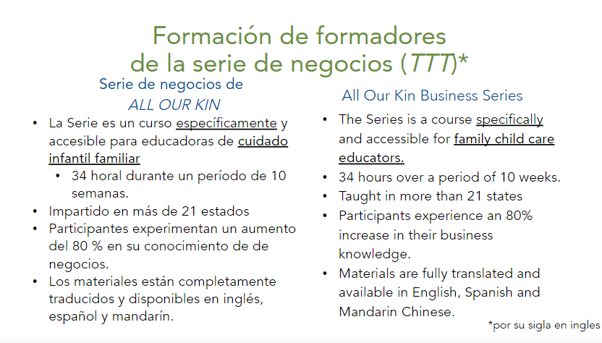

Slide 36
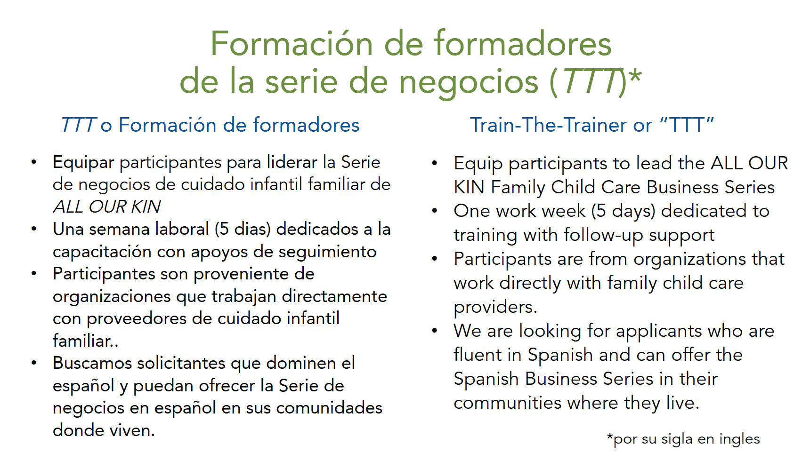

Slide 37
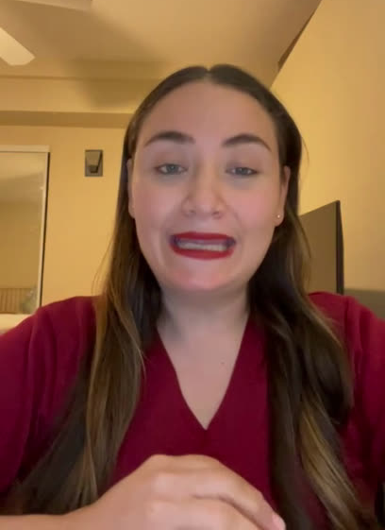
TTT Testimony from
Diana Beltran CCPU SPN

Slide 38
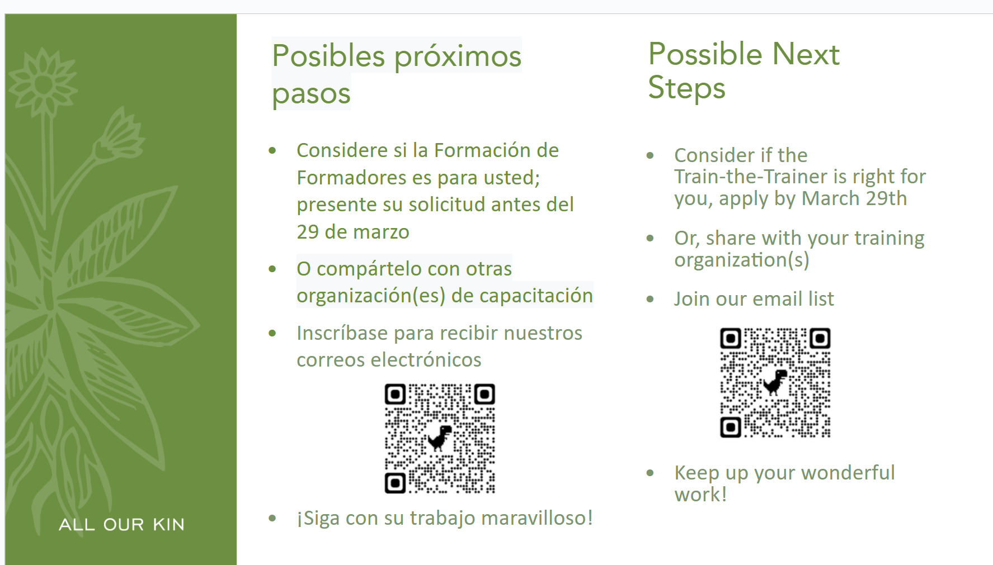

Slide 39
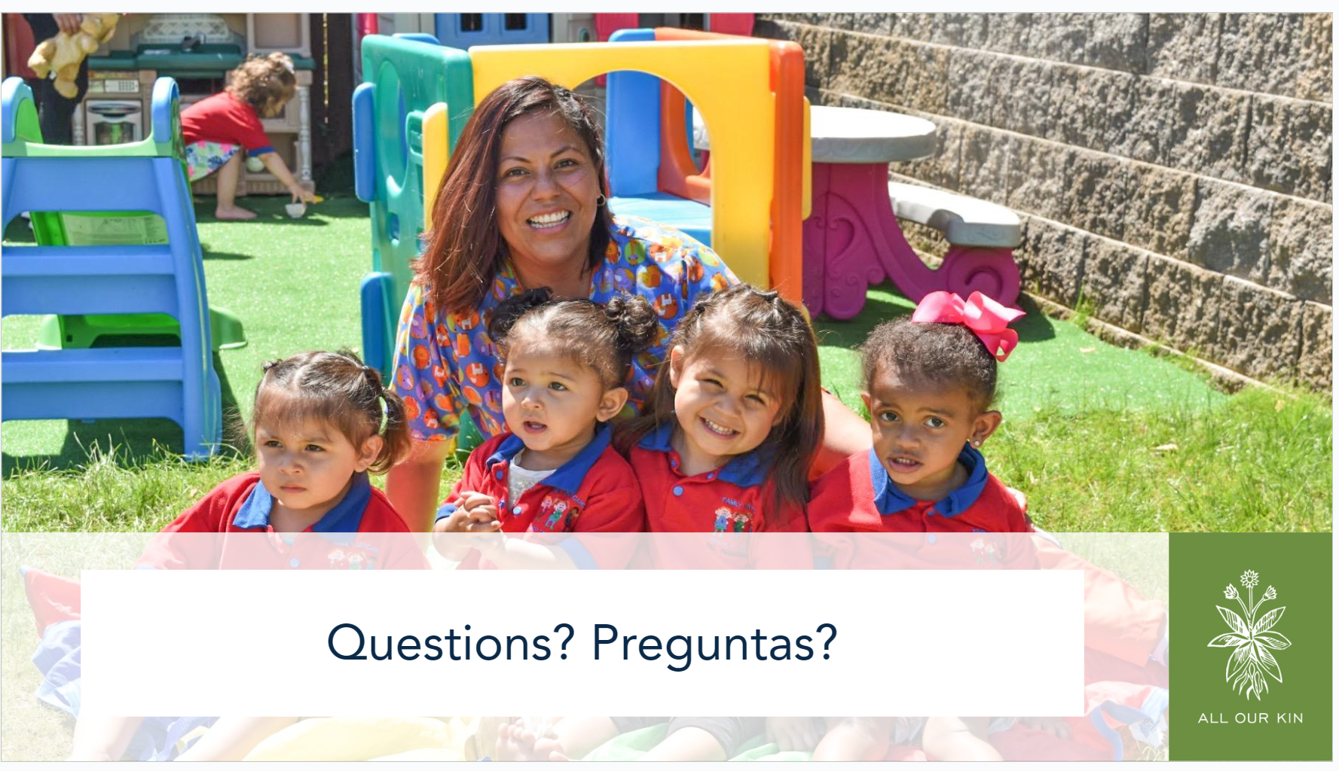

Slide 40

Rosanna Matos, M.Ed.
Early Learning Program Engagement Specialist
Notes:
Is on Vacation this week soaking up the sun...
Damaris Will share

Slide 41


Slide 42

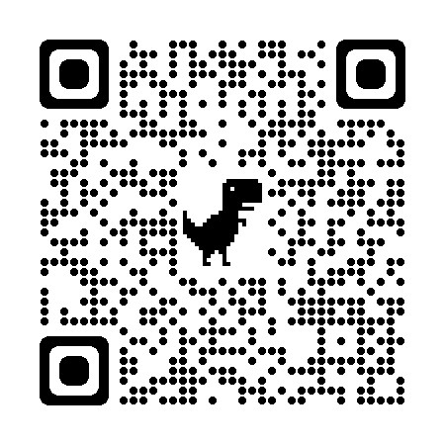
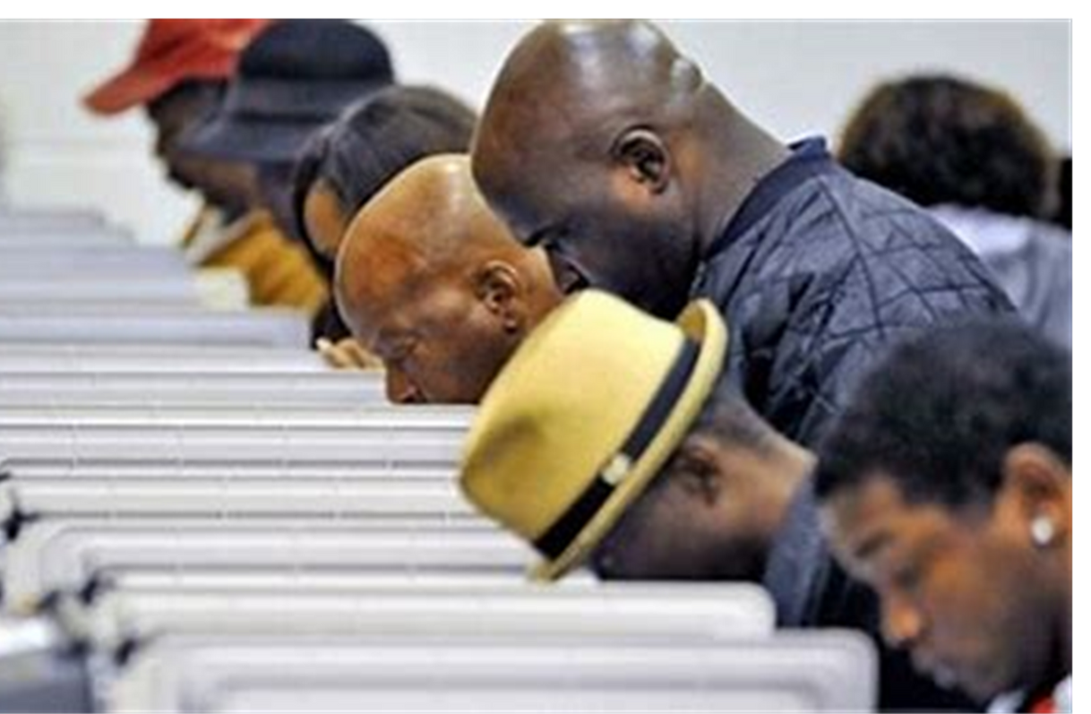
Apoyando a las familias y educadores a que salgan a votar
Getting Staff & Families Out to Vote
Tuesday, April 2, 2024
06:30 PM - 08:30 PM
Abierto para todos!
Horas PQAS para educadores
https://www.papdregistry.org/v7/trainings/search/(slider-new:365006/detail)

Slide 43
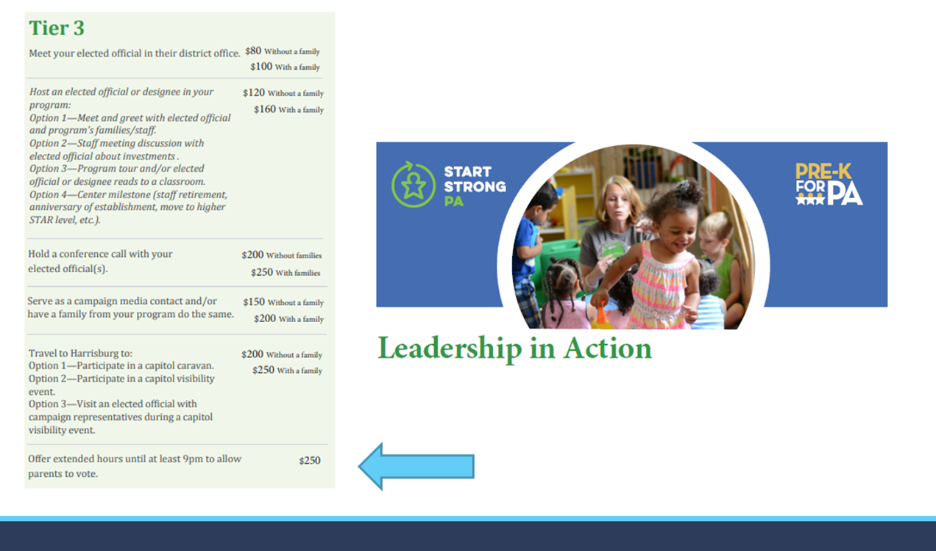
Dejar su programa abierto unas Horas extendidas para que familias salgan a votar

Slide 44
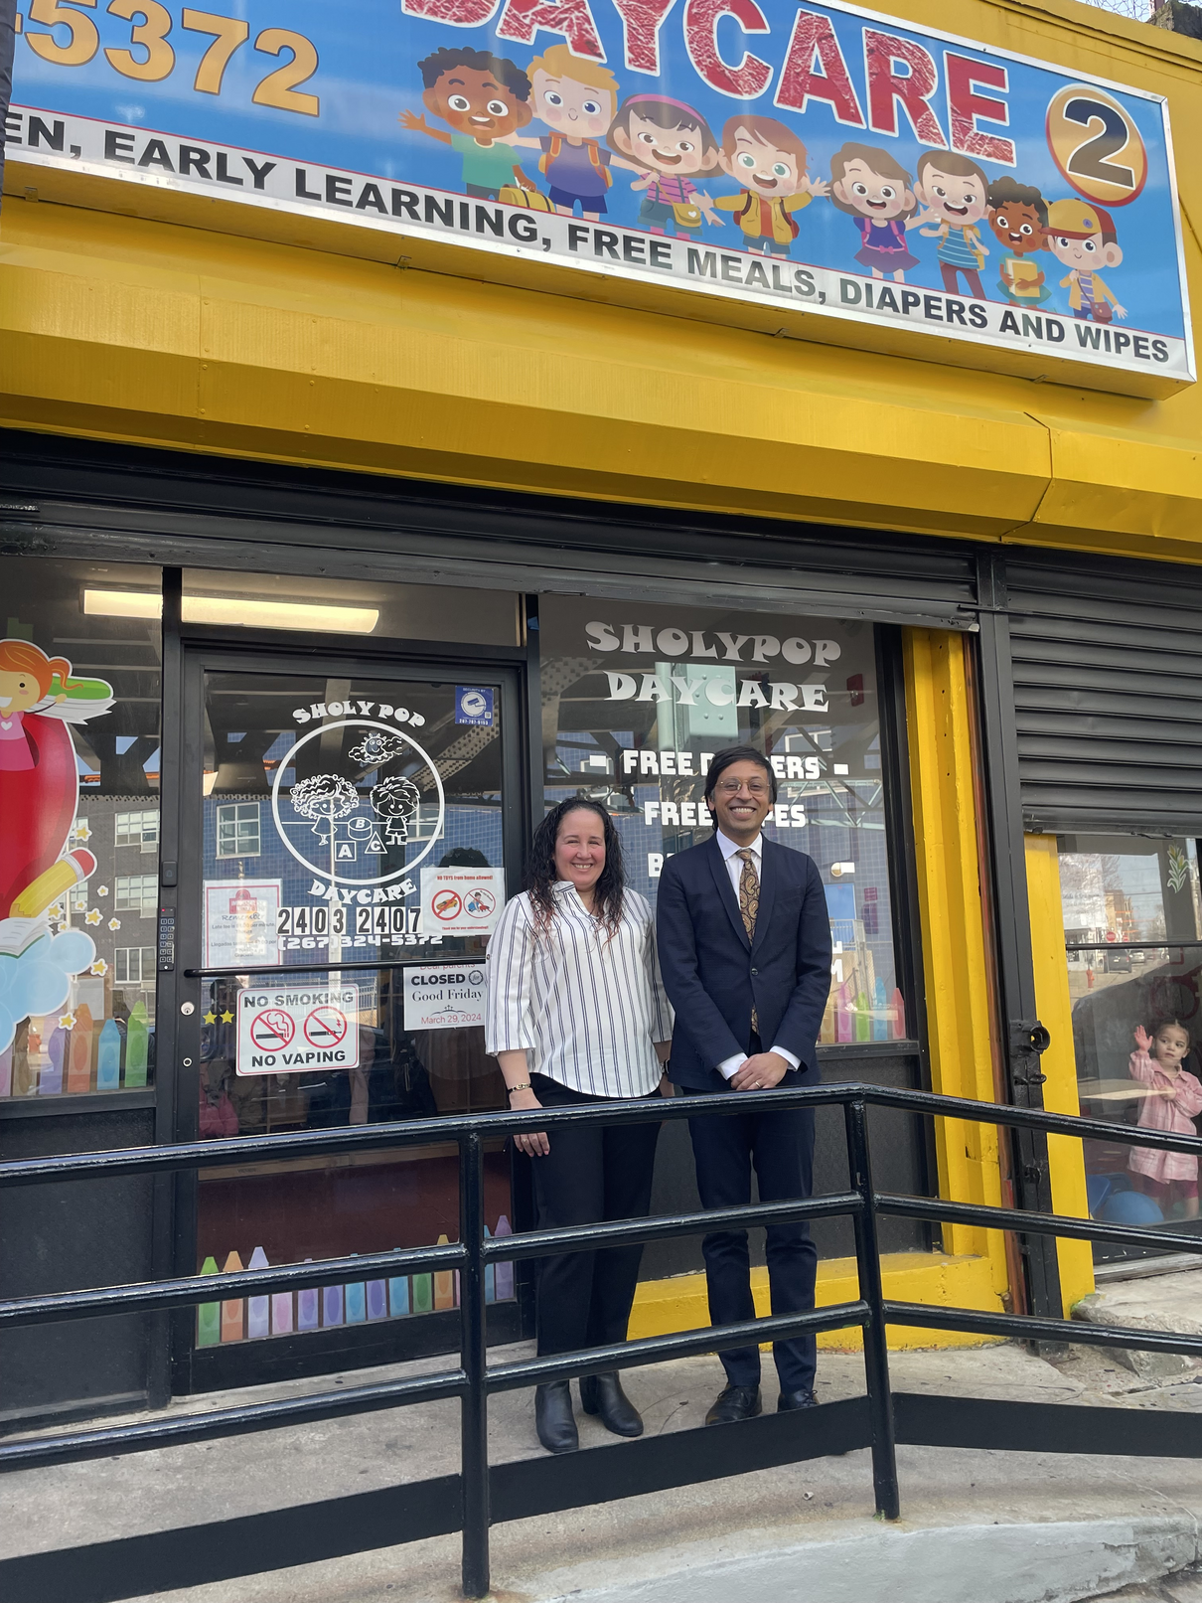
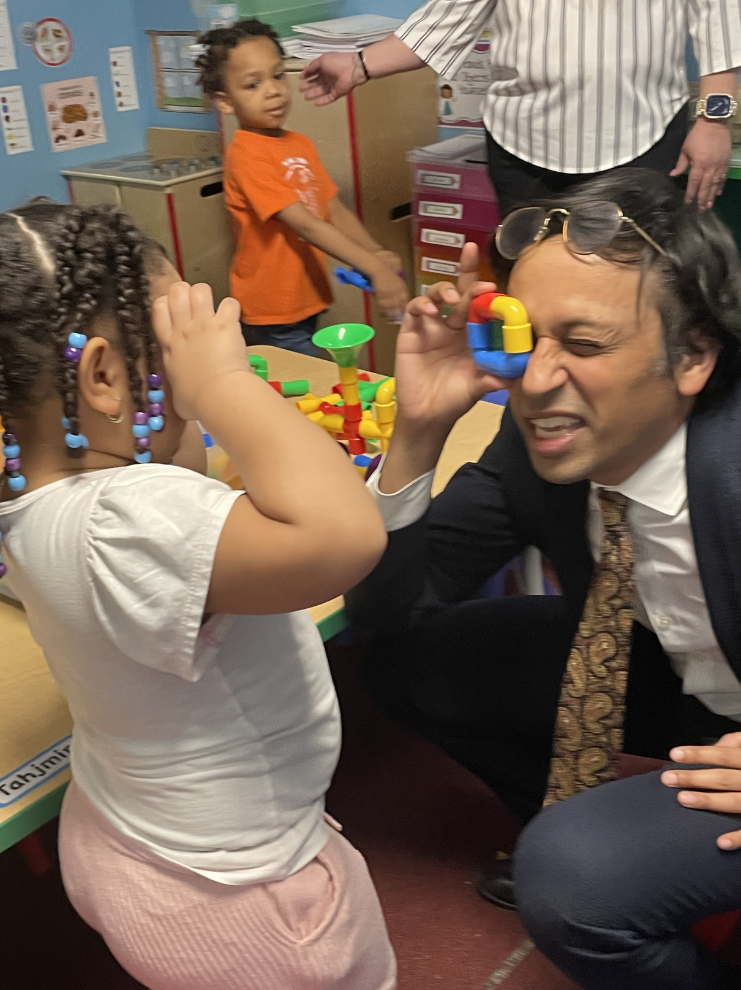
WEEK OF THE YOUNG CHILD
Semana del nino pequeno
8-12 de abril de 2024
Invite a tu legislador!
rosanna.matos@firstup.org

Slide 45
Damaris Alvarado-Rodriguez
Latinos Educando Juntos
Notes:
Is on Vacation this week soaking up the sun...
Damaris Will share

Slide 46













WEEK OF THE YOUNG CHILD
TOOLKIT

Slide 47

INTRODUCTION
The Week of the Young Child® is an annual celebration sponsored by the National Association for the Education of Young Children (NAEYC), the world's largest early childhood education association, with nearly 60,000 members and a network of 51 Affiliates.
The purpose of the Week of the Young Child® is to focus public attention on the needs of young children and their families and to recognize the early childhood programs and services that meet those needs.
NAEYC invites you to celebrate and shine a spotlight on your classroom, advocacy, and family engagement activities via their social channels.
https://www.naeyc.org/events/woyc

Slide 48

WOYC ACTIVITY RESOURCES
SEMANA DEL NIÑO PEQUEÑO ACTIVIDAD Y RERECURSOS
Music Monday
Lunes de Música
Tasty Tuesday
Martes sabroso
Work Together Wednesday
Trabajar juntos el Miércoles
Artsy Thursday
Jueves artístico
Family Friday
Viernes Familiar
https://www.naeyc.org/events/woyc

Slide 49
MUSIC MONDAY
ACTIVITY: MAKE AN INSTRUMENT AND SING LULLABIES FROM DIFFERENT CULTURES
Encourages creativity and play with the kids. Let's get those imaginations fired up and make some musical magic! 🎶🌟
Invite parents to create an instrument with their children.
Encourage parents to share a lullaby from their cultural heritage with the children. Imagine the joy of everyone singing together, accompanied by their DIY instruments! It's a beautiful way to celebrate diversity and create lasting memories.
Here are some Hispanic lullabies for children:
Here are simple instruments that they make:
  Tin Can Drum
  Elastic Band Guitar
  Plastic Egg Maracas
  Arrorró mi niño
  A la nanita nana
  Duerme ya
  Duerme Negrito
  Duerme Dulce Niña

Slide 50




TASTY TUESDAY
ACTIVITY: ASK THE KIDS TO BRING SNACKS FROM THEIR CULTURE
Partner with families to bring in healthy snacks from their cultures. Create a map of the world and mark where each snack comes from. Discuss ingredients and flavors together.
Traditional Hispanic Snacks:
  Fruit Cups
  Paletas
  Guacamole
  Ate Con Queso
  Nachos & Tortillas
Encourages sharing and support communication skills. This will also help kids get familiar with various foods from different cultures.
https://www.naeyc.org/events/woyc

Slide 51
WORK TOGETHER WEDNESDAY
ACTIVITY: SCAVENGER HUNT
Encourages children to be active and explore. This would also help them learn about teamwork. 🌈
Ask them to find 5 things that are:
  big
  small
  soft
  hard
Ask the children to find and collect items around the classroom in certain colors.
Ask them to find and collect items in certain shapes.
OR
OR
https://www.naeyc.org/events/woyc

Slide 52
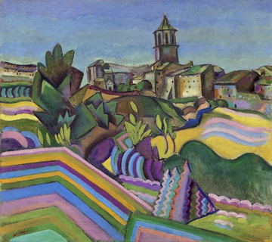
ARTSY THURSDAY
ACTIVITY: PREPARE A LOT OF MATERIALS LIKE PAINT, COLORED PENS, MARKERS
Helps develop cognitive, social-emotional, multisensory and fine motor skills of our children.✨
01
02
03
Read a folktale from a different culture together. Provide materials like paints, markers, and collage materials for children to illustrate their favorite parts of the story.
Choose a Hispanic Artist and ask the children to draw their own version of the artist’s famous work.
Provide children with assorted paper squares of various colors and invite them to create an artwork from these pieces. Help them count how many colors they used in their artwork. Simple math art, right?🤩
Some folktales are:
  El Puma y el Saltamontes
  La Mazorca de Oro
  Anahí y la Flor de Ceibo
Artist: Joan Miró
Artwork:
https://www.naeyc.org/events/woyc

Slide 53
FAMILY FRIDAY
ACTIVITY: FAMILY TREE AND POTLUCK LUNCH
Encourages children to be active and explore. This would also help them learn about teamwork. 🌈
Encourage families to share stories, photos, or artifacts that represent their cultural heritage. Consider inviting grandparents or other family members to participate.
Together with the parents/ grandparents, the children could create a family tree from the photos they brought. Children can present about their family backgrounds to the class.
Organize a potluck lunch where families bring dishes from their cultures. Encourage discussions about family mealtime traditions.
https://www.naeyc.org/events/woyc

Slide 54
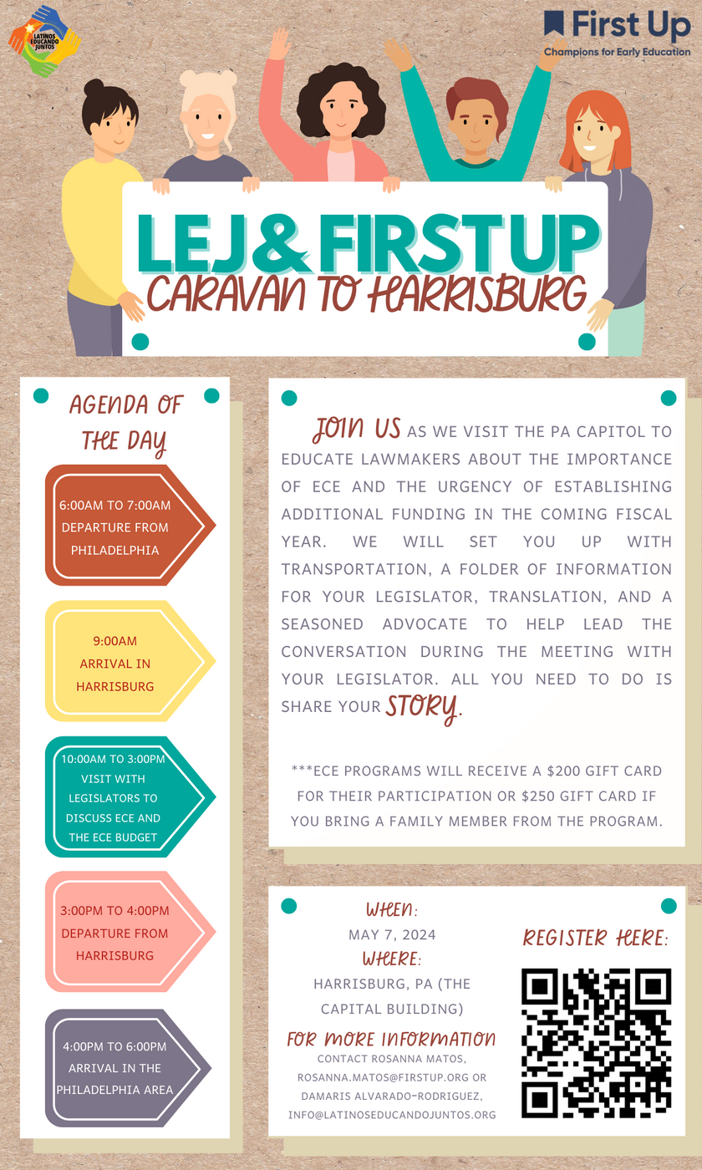
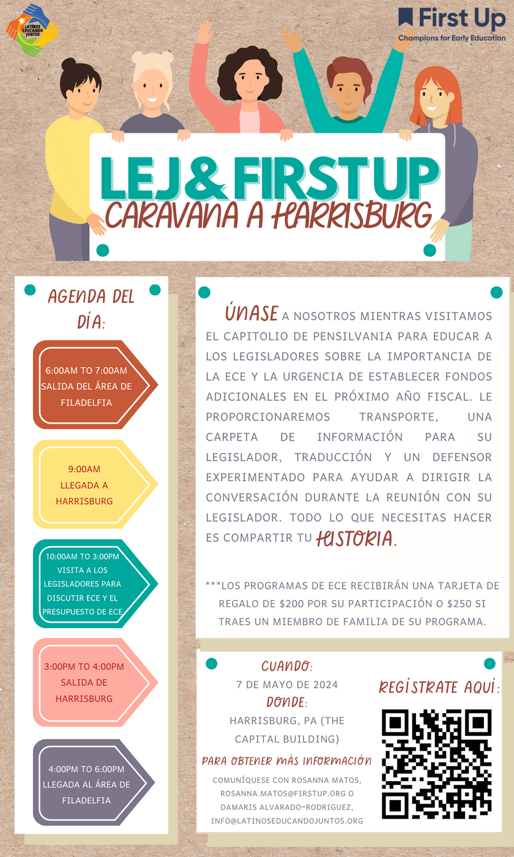
May 7th, 2024
Bring your families, teachers, students, yourselves and Lift your voices!
Join US!
Register now!
Notes:
https://docs.google.com/forms/d/e/1FAIpQLSeC_GgEFCdSPE12EPRCTXp7EGkdgyFVn1EGMoyv80G7eWGQLw/viewform

Slide 55

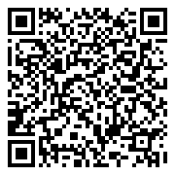
SCAN HERE TO COMPLETE SURVEY

Slide 56



Slide 57



Slide 58



Slide 59




Slide 60


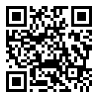
STAY CONNECTED

Slide 61
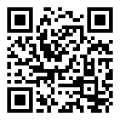
EXIT SURVEY
Please take a moment to complete
the Exit Survey
Por favor, tómese un momento para completar
la Encuesta de Salida

Slide 62


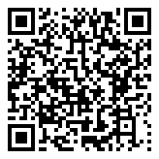
Thank you!
Gracias!
Next Provider Meeting will be on Friday, April 19th from 1pm-3pm

